Slide 1
PARLER LENTEMENT
(A mettre aussi sur une feuille)

Slide 2
University Physics I, Mechanics - Lesson 4:
February 2021– June 2021
Teacher: Dr. Paul Briard
Email: paulbriard@outlook.com
Wechat: Paulbg123
Notes:
PARLER LENTEMENT: Hello everybody, it’s a pleasure to meet you to teach the 4th lesson about Mechanics.

Slide 3
The Newton’s laws of motion
Notes:
PARLER LENTEMENT: And this time, we will see together the Newton’s laws of motion. Last time, we have seen together what is an inertial reference frame. And we have seen that an inertial reference frame is a reference frame where the Newton’s laws of motion are verified. Let’s then to describe them.

Slide 4
Contents
Forces exerted on a body
The three Newton’s laws of motion (in inertial frame of reference)
The frictional forces
The dynamic of body in circular motion
Notes:
PARLER LENTEMENT: Before to describe the Newton’s laws. It is necessary to describe the forces exerted on a body. This is because the motion of a body depend on the forces exerted on him. Then I will describe the 3 Newton’s laws. I say here in an inertial reference frame because it is possible to generalize them in non-inertial reference frame. But it is a topic we will not discuss today. Then, I will describe you details about the frictional forces and finally the dynamic body of circular motion. Maybe we will not finish this content today, but it doesn’t matter. What we don’t see today will be seen next time.

Slide 5
I. Forces exerted on a body
Notes:
PARLER LENTEMENT: So, first, let’s to remind you the forces exerted on a body.

Slide 6
Meaning of “Forces” in Physics
A force is an interaction between two bodies.
Notes:
PARLER LENTEMENT: First, what is the meaning of force, in Physics ? A force is an interaction between two bodies. For instance, if you pull or push by your hand an object as your phone, you exert a force on it.

Slide 7

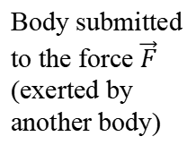
Meaning of “Forces” in Physics
A force is an interaction between two bodies.
A force is described by a vector, it is characterized by
its direction
its strength (also named magnitude), unit: Newton (symbol: N)
Body submitted to the force $\vec{F}$ (exerted by another body)
$$\vec{F}$$
Notes:
PARLER LENTEMENT: A force a characterized by its direction and its strength. Depending to at which direction and strength you push or pull your phone, for instance, the motion could be different. Because of these characteristics, the Forces are described in Physics by using vectors. The direction of the vector is the direction of the force. The length of the vector, which describe its magnitude, describe the strength of the force. Here you see an example of the force F exerted on a body. This force is exerted by another body which is not shown on the figure.

Slide 8

Different kinds of forces
The normal force $\vec{n}$
Normal force exerted by the table on the object
Object on the table
$$\vec{n}$$
Surface (for instance a table)
An object on a table don’t fall because the table exert a normal force on it.
Notes:
PARLER LENTEMENT: So, here is a first example of force, the normal force. As you know, “normal” means in Physics “perpendicular”. If you have an object on a table such as a phone, a dial, your hand or anything, this table exerts a force on it, the normal force. The object on the table don’t fall because there is this table which exert a force on it. The symbol we will use to describe the normal force is the letter n. In this example, n is directed upward because the inclination of the table is horizontal but of course, the table could have another inclination.

Slide 9
Different kinds of forces
The normal force $\vec{n}$
Normal force exerted by the table on the object
Object on the table
$$\vec{n}$$
Surface (for instance a table)
An object on a table don’t fall because the table exert a normal force on it.
The normal force is perpendicular with the surface of contact.
The normal force is always pushing (directed from the table to the object)
Notes:
PARLER LENTEMENT: The normal force is always perpendicular with the surface of contact, here between the table and the object on it. And the normal force is always pushing from the body which exert the normal force to the body at which this normal force is exerted.

Slide 10
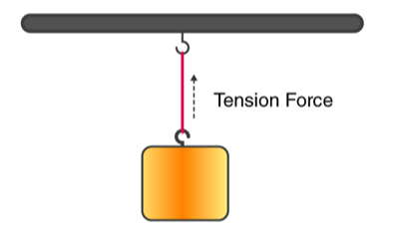

Different kinds of forces
The tension force $\vec{T}$
https://byjus.com/physics/tension/
The object suspended don’t fall because the rope exert on it a tension force.
The direction of the tension force is along the rope. The tension force is always pulling (i.e. directed from the object to the rope).
Notes:
PARLER LENTEMENT: Here is another example of force. The tension force. Here you can see a object like a cube but it could be anything suspended by a rope. The object suspended don’t fall because the rope exert on it a force, named “the tension force”. The tension force is always pulling, directed from the object to the rope. In this example, the tension force is upward, but a rope could pull an object in other direction, for instance at the horizontal, we will see in the next slide.

Slide 11
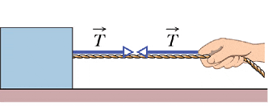
Different kinds of forces
The tension force $\vec{T}$
https://www.physicsforums.com/threads/direction-of-tension-force.806174/
Another example of tension forces exerted by the rope (on the hand, on the object).
Notes:
PARLER LENTEMENT: Here you can see another example of using a tension force to pull an object. As you see, the tension force is exerted at the both side of the rope. So there is one tension force exerted on the cube at the left and one tension force exerted on the hand at the right. Because of the tension force the cube could be pulled to move toward the right, in this example.

Slide 12
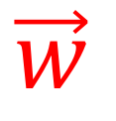

Different kinds of forces
The weight $\vec{w}$
Body submitted to its weight
$$\vec{w}$$
The weight is the gravitational force exerted by the Earth on the body.
Warning: Don’t confuse the weight and the mass !
Notes:
PARLER LENTEMENT: Here is a force you should know well. It is the gravitational force exerted by Earth on a body, and its named the weight. The weight is directed toward the center of the Earth so it is always directed downward, toward the ground. It is the reason why you cannot fly by jumping. To describe the weight, I will use the letter w (double u). Take care that in daily life, weight and mass have the same meaning. But in physics, the weight is the not the mass of the body. It is the gravitational force which depends on the mass of the body,

Slide 13

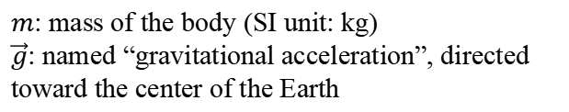

Different kinds of forces
The weight $\vec{w}$
Body submitted to its weight
$$\vec{w}=m\vec{g}$$
$m$: mass of the body (SI unit: kg)
$\vec{g}$: named “gravitational acceleration”, directed toward the center of the Earth
$$\vec{w}$$
$g=9.81$ $m.s^{−2}$
The weight is the gravitational force exerted by the Earth on the body.
Warning: Don’t confuse the weight and the mass !
Notes:
PARLER LENTEMENT: Here is how the weight depend on the mass of the body, named m. As you know, g is the gravitational acceleration, directed toward the center of the Earth. The magnitude of the gravitational acceleration vector is 9.81 (nine dot heighty one) meters per square seconds. I said you that usually, you don’t have to remember a constant, but this one is very important so please to remember it.

Slide 14
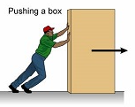


Different kinds of forces
The friction force $\vec{f}$
Motion of the box
$$\vec{f}$$
It is not so easy for this person to push the box because a friction force is exerted on the box by the ground.
Direction of the friction force: always opposed to the motion of the body.
Notes:
PARLER LENTEMENT: You already try to move heavy things on the ground, right ? Why it is so difficult ? It is because of the friction force. In the situation you see on the figure, the ground exert not only the normal force on the box, but also a friction force. This is why it is not so easy for this person to push the box. This is because a friction force is exerted on the box by the ground and the direction of this force is opposite to the motion of the body, here the box.

Slide 15
Different kinds of forces
The friction force $\vec{f}$
Motion of the box
$$\vec{f}$$
There are two kinds of friction force: the static friction (the body don’t move) and the dynamic friction, also named “kinetic friction” (the body moves), more details will be given later.
Notes:
PARLER LENTEMENT: There are two kinds of friction force exerted on a body. The static friction force where the body don’t move. But how is the direction of the force which should be opposite to the motion can be described if this body don’t move ? It is something we will see later. The second kind of friction force is the dynamic friction force, where the body move. I don’t give you more details now, because I just describe in this first part of the lecture few kinds of forces. The dynamic friction force which is the friction force when the body moves is also named the kinetic friction.

Slide 16
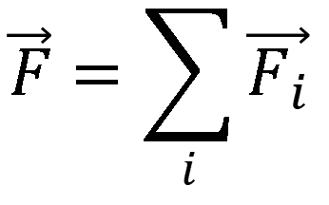
The net force
$$\vec{F}=\sum_{i}{\vec{F_{i}}}$$
Net force exerted on the body
Individual forces exerted on the body
The net force on a body (also named “total force”) is the superposition of all the force exerted on this body.
Notes:
PARLER LENTEMENT: We have seen together different kinds of forces. In many situations, there is not only one force exerted on a body but few or many of them. Thus, it is necessary to describe the sum of all of these forces exerted on the body. To describe it, we use the name “net force” or also “total force”. The net force exerted on a body is the sum of all the individual forces exerted on this body. In equation, it is simply described by the equation you see here, where F i is one of the individual force, for instance the weight, exerted on the body.

Slide 17





The net force
Example:
$${\vec{F}}_{1}$$
body submitted to 4 forces: $\vec{F_{1}},$…
$${\vec{F}}_{4}$$
$${\vec{F}}_{2}$$
$${\vec{F}}_{3}$$
Notes:
PARLER LENTEMENT: Here is an example where you will see the net force is a useful concept. There is a body such as a box for instance where four forces are exerted: F 1, F 2, F3, F 4. And we would to describe the motion of this body.

Slide 18


The net force
Example:
$${\vec{F}}_{1}$$
body submitted to 4 forces: $\vec{F_{1}},$…
Equivalent with
body submitted to 4 forces: $\vec{F_{1}},$…
$${\vec{F}}_{4}$$
$${\vec{F}}_{2}$$
$$\vec{F}$$
Net force:
$\vec{F}={\vec{F}}_{1}$+${\vec{F}}_{2}$+${\vec{F}}_{3}$+${\vec{F}}_{4}$
$${\vec{F}}_{3}$$
Notes:
PARLER LENTEMENT: So, this situation is equivalent to the figure at the right, where only the force F is exerted on the body. This force F is the net force and is the sum of the individual forces shown at the left.

Slide 19
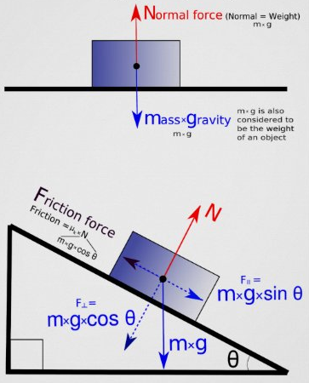
Free body diagram
A free body diagram is a diagram where are represented the forces exerted on a body
Examples of free body diagram
https://www.zazzle.com/physics_free_body_force_diagram_poster-228913862769275827
Notes:
PARLER LENTEMENT: Here, we will speak about the free body diagram, which is often useful to study the motion. In a free body diagram, we describe the forces exerted on a body. For instance, in this figure, there is the normal force and the weight exerted on the box on a table.

Slide 20
Free body diagram
A free body diagram is a diagram where are represented the forces exerted on a body
Examples of free body diagram
To simplify the study, the forces could come from the center of gravity of the body studied (it is not an obligation).
https://www.zazzle.com/physics_free_body_force_diagram_poster-228913862769275827
The forces that exert this body on other bodies are not shown.
Notes:
PARLER LENTEMENT: To simplify the study, we can draw the force from the center of gravity of the body we are interested. This is what is shown in this example. This is not an obligation, you could draw the forces from the point where they are exerted on the body. Also, in the free body diagram, only the forces exerted on the body are drawn. And the forces that are exerted by the body for instance, the normal force exerted by the box on the table, are not shown on the free body diagram.

Slide 21
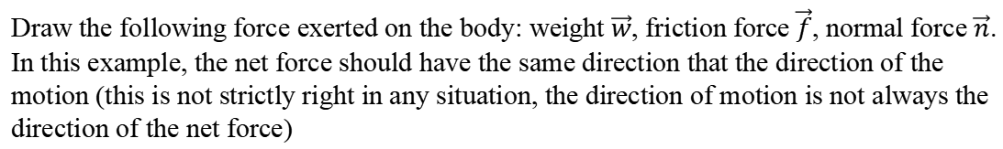
Ex. Free body diagram of an object on an inclined plane (5 minutes)
center of mass
motion
Draw the following force exerted on the body: weight $\vec{w}$, friction force $\vec{f}$, normal force $\vec{n}$. In this example, the net force should have the same direction that the direction of the motion (this is not strictly right in any situation, the direction of motion is not always the direction of the net force)
Notes:
PARLER LENTEMENT: Here is another example of situation. The forces exerted on the box are not shown because this is the purpose of this little exercise. You can see that the direction of motion is shown on the figure. Also take care that here, we don’t have a box on an horizontal table but on an inclined table. Please to draw the three following forces exerted on the box: the weight, the friction force, and the normal force. On the wechat group, 5 minutes later, I will ask to a student to share what he have done. For this exercise, please to draw the three forces from the center of mass of the box.

Slide 22



Another example of free diagram body: mobile on inclined plane
$$\vec{n}$$
center of mass
$$\vec{f}$$
$$\vec{w}$$
motion
Forces exerted on the body: weight $\vec{w}$, friction force $\vec{f}$, normal force $\vec{n}$.
About the magnitude of the vectors, we will see later how to describe them.
Notes:
PARLER LENTEMENT: Here is the solution. First, the weight. We know that the weight is directed downward. The normal force exerted by the inclined table is directed from the table to the box and is perpendicular to the surface of contact between the table and the box. Finally, there is a friction force. The direction of the friction force is opposite to the motion. I didn’t speak about the magnitudes of these forces. I didn’t choose them carelessly. If you add these three vectors, you will see that the net force has same direction that the motion, in this example. I say in this example, because the direction of motion is not always the direction of the net force. Later we will see, how to describe their magnitude individually.

Slide 23
II. The Newton’s laws of motion
Notes:
PARLER LENTEMENT: I have described to you few examples of forces, the net force and the free body diagram. Now, let’s see the Newton’s laws of motion.

Slide 24


The Newton’s first law
The net force on this object is zero:
$$\vec{F}=\sum_{i}{\vec{F_{i}}}=\vec{0}$$
It moves at constant velocity or stays at rest
“A body submitted to no net force (i.e. zero net force) move at constant velocity vector or stays at rest.”
Notes:
PARLER LENTEMENT: Here is the Newton’s first law. In the figure you can see an example. Imagine the two people who push the stone exert opposite forces and of equal magnitude. There is also the weight and the normal force exerted by the ground, but they have also opposite direction and equal magnitude. So, in this example the net force exerted on the stone is zero. It was at the rest and stays at rest. The Newton’s first law is then as follows: A body submitted to zero net force move at constant velocity vector or stays at rest. This means that the net force exerted on a body change its velocity vector. Here, you have an example where if the net force exerted on a body is zero, and stay at rest. Later, we will see example where the body moves at constant velocity vector.

Slide 25
The Newton’s first law
In equations, the Newton’s first law is described as follows:
$$\vec{F}=\sum_{i}{\vec{F_{i}}}=\vec{0}$$
If the net force on an object is zero
Notes:
PARLER LENTEMENT: Let’s to describe the Newton first law in equations. First, the case of the zero net force is described by this equation: the sum of each individual forces is zero.

Slide 26


The Newton’s first law
In equations, the Newton’s first law is described as follows:
$$\vec{F}=\sum_{i}{\vec{F_{i}}}=\vec{0}$$
If the net force on an object is zero
$$\frac{d\vec{v}}{dt}=\vec{0}$$
The object moves at constant velocity vector (or stays at rest, i.e. $\vec{v}=\vec{0}$)
Notes:
PARLER LENTEMENT: And in that situation, the Newton first law says that the body is moving at constant velocity vector or stays at rest, which means the time derivative of the velocity vector is zero. If the body is at rest, the velocity vector is zero, and stays of magnitude zero.

Slide 27


The Newton’s first law
In equations, the Newton’s first law is described as follows:
$$\vec{F}=\sum_{i}{\vec{F_{i}}}=\vec{0}$$
If the net force on an object is zero
$$\frac{d\vec{v}}{dt}=\vec{0}$$
The object moves at constant velocity (or stays at rest, i.e. $\vec{v}=\vec{0}$)
$$\vec{a}=\vec{0}$$
The acceleration of the object is zero
Notes:
PARLER LENTEMENT: We know that the acceleration vector is the time derivative of the velocity vector. So, if the net force exerted on a body is zero, its acceleration vector is zero. The body doesn’t have an acceleration.

Slide 28
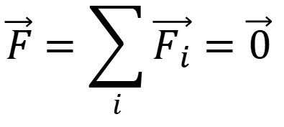
The Newton’s first law
$$\vec{F}=\sum_{i}{\vec{F_{i}}}=\vec{0}$$
the net force on an object is zero, the body is in equilibrium
A body at rest or moving at constant velocity $\vec{v}$ is said “body in equilibrium”
Notes:
PARLER LENTEMENT: The Newton first law describe situations where bodies are said in equilibrium. This word simply means that the net force exerted on them is zero.

Slide 29
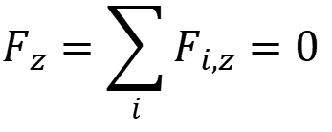
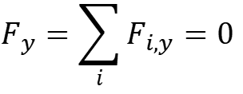
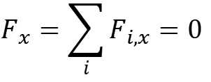
The Newton’s first law
$$\vec{F}=\sum_{i}{\vec{F_{i}}}=\vec{0}$$
the net force on an object is zero, the body is in equilibrium
A body at rest or moving at constant velocity $\vec{v}$ is said “body in equilibrium”
$$F_{x}=\sum_{i}{F_{i,x}}=0$$
$$F_{y}=\sum_{i}{F_{i,y}}=0$$
$$F_{z}=\sum_{i}{F_{i,z}}=0$$
Each component of the net force exerted on such body is zero
Notes:
PARLER LENTEMENT: As you know, rather than the vectors we can describe them by their component. Here are the Cartesian component of the net force. They are the sum of the corresponding components x, y, z of the individual forces exerted on the body. If the net force is zero, it means that the x, y, and z, components of the net force is zero. This will be very useful later to describe forces and their components exerted on a body.

Slide 30
The Newton’s first law
Warning: The Newton’s first law is only valid in inertial frames of reference
!
A definition of an inertial frame of reference is “a frame of reference where the Newton’s first and second laws are valid” …
Notes:
PARLER LENTEMENT: The Newton first law is not valid in all reference frames. It is valid only in inertial reference frames. And if the reference frame is not inertial, we cannot use it.

Slide 31
The Newton’s first law
Warning: The Newton’s first law is only valid in inertial frames of reference
!
A definition of an inertial frame of reference is “a frame of reference where the Newton’s first and second laws are valid” …
An inertial frame of reference is at rest or move at constant velocity in respect to another inertial frame of reference
A frame of reference attached to the ground is not strictly inertial (because of the rotational motion of Earth) but is approximately considered as inertial.
Notes:
PARLER LENTEMENT: An inertial reference frame is at rest or move at constant velocity in respect to another inertial reference frame. It is something we have seen together last time. Take care because a reference frame attached to the ground is not strictly inertial. This is because of the rotational motion of the Earth. But we can approximately consider it as an inertial reference frame, as if Earth has no rotational motion. This is because we will describe situations where this rotational motion can be ignored.

Slide 32
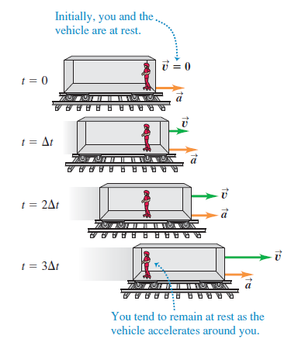
Examples of non-inertial frame of reference
Notes:
PARLER LENTEMENT: Now, I will show you few examples of non-inertial frames of reference. Imagine a passenger on a train, you. You have rollers, so there is no friction with the ground of the train. Initially, the train is at rest. At time t equal 0 its velocity is zero. Then, the train moves toward the right, its velocity increase and its acceleration is constant. In such situation, we consider a frame of reference attached to the train, which is not an inertial frame of reference. During the motion of the train, you will tend to remain at rest in respect to the ground but you will move in the reference frame attached to the train, which means you cannot use the first Newton law for the reference frame attached to the train.

Slide 33
Rest time (5 minutes)

Slide 34
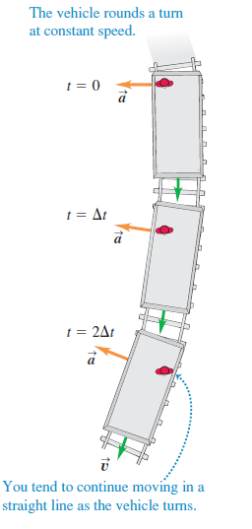
Examples of non-inertial frame of reference
We want to describe the motion of the person in the vehicle in a frame of reference attached to the vehicle. If the vehicle is accelerating or turn, the reference frame is not inertial.
Notes:
PARLER LENTEMENT: Here is another example. But now the train is turning at constant speed. Initially the train velocity vector is downward, then the train turn toward the left. But you will tend to continue your motion as straight line in the reference frame attached to the ground. In the reference frame attached to the train, you don’t stay at rest or moves at constant velocity in this kind of situation,

Slide 35
Example of non-inertial frame of reference
We want to describe the motion of the person in the vehicle in a frame of reference attached to the vehicle. If the car is accelerating or turn, the reference frame is not inertial.
The Newton’s first law is here not valid !
Notes:
PARLER LENTEMENT: To summary, the Newton’s first law is only valid in the inertial reference frames, such as attached to the ground, if we consider it as approximately inertial. The Newton 1st law is not valid if the reference frame is not inertial. To know if a reference frame is inertial or not, you should remember that an inertial reference frame stays at rest of move at constant velocity vector in respect with another inertial reference frame, such as the one attached to the ground.

Slide 36
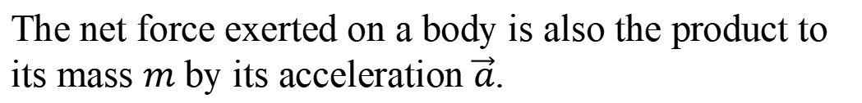

The Newton’s second law
$$\vec{F}=\sum_{i}{\vec{F_{i}}}=m\vec{a}$$
The net force exerted on a body is also the product to its mass $m$ by its acceleration $\vec{a}$.
Notes:
PARLER LENTEMENT: Now, let’s describe the Newton’s second law. The equation which describe it is quite simple. The Newton’s second law says that the net force exerted on a body is the product between the mass of the body and the acceleration of this body.

Slide 37

The Newton’s second law
$$\vec{F}=\sum_{i}{\vec{F_{i}}}=m\vec{a}$$
The net force exerted on a body is also the product to its mass $m$ by its acceleration $\vec{a}$.
Then, the acceleration vector of the body is described by:
$$\vec{a}=\frac{\vec{F}}{m}=\frac{\sum_{i}{\vec{F_{i}}}}{m}$$
Important to remember
Notes:
PARLER LENTEMENT: Thus, if you know the net force exerted on a body, you can describe its acceleration vector at any time. It is the ratio between the net force exerted on the body and its mass. Please to remember this expression of the acceleration vector because it will be very useful later.

Slide 38
The Newton’s second law
$$\vec{F}=\sum_{i}{\vec{F_{i}}}=m\vec{a}$$
The net force exerted on a body is also the product to its mass $m$ by its acceleration $\vec{a}$.
Then, the acceleration vector of the body is described by:
$$\vec{a}=\frac{\vec{F}}{m}=\frac{\sum_{i}{\vec{F_{i}}}}{m}$$
Important to remember
If you know the net force exerted on a body, you can describe its acceleration vector, thus you can describe its motion, using $\vec{a}=d\vec{v}/dt$
Notes:
PARLER LENTEMENT: And if you know the acceleration vector, you can describe its motion, because you know that the acceleration vector is the time derivative of the velocity vector. Of course, if you know how change the velocity vector, you will be able to describe how change the coordinates of the body.

Slide 39
The Newton’s second law
$$\vec{F}=\sum_{i}{\vec{F_{i}}}=m\vec{a}$$
For the case of no acceleration $(\vec{a}=\vec{0}$), the body is at equilibrium (moves at constant velocity or stay at rest)
Newton’s first law
Warning: As for the Newton’s first law, the Newton’s second law is only valid in inertial frame of reference.
Notes:
PARLER LENTEMENT: A particular case of the Newton second law is when the body has no acceleration because the net force exerted on him is zero. In that case you obtain simply the Newton first law we have described. Take care about the Newton second law that it is valid only in inertial frame of references, as for the Newton’s first law.

Slide 40

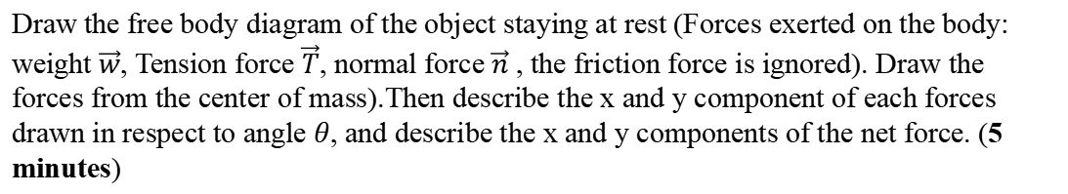
Ex: object on inclined plane
rope (exert a tension)
$$y$$
center of mass
$$x$$
$$θ$$
Draw the free body diagram of the object staying at rest (Forces exerted on the body: weight $\vec{w}$, Tension force $\vec{T}$, normal force $\vec{n}$ , the friction force is ignored). Draw the forces from the center of mass).Then describe the x and y component of each forces drawn in respect to angle $θ$, and describe the x and y components of the net force. (5 minutes)
Notes:
PARLER LENTEMENT: To see if you have understood here is a little exercise, please to try to do it in 5 minutes. In is not exactly the same situation than in the first exercise. Here the box is at rest. I ask you first to draw the free body diagram on the box on the inclined table. Take care that here, there is rope which exert a tension force on the box. Then, please to describe the x-and y- components of each force and of the net force.

Slide 41

Ex: object on inclined plane
Object at rest (or moving at constant velocity)
$$\vec{F}=\sum_{i}{\vec{F_{i}}}=\vec{0}$$
$$y$$
$$\vec{T}$$
$$\vec{n}$$
$$x$$
$$θ$$
Notes:
PARLER LENTEMENT: Here, the box is at rest, which means the net force exerted on it is zero. We have to take care of that we draw the free body diagram. About the weight, I will draw it later. First, I show the normal force exerted on the box, the red vector n. Its direction is perpendicular to the surface of contact between the box and the inclined table. Now there is a tension force T exerted on the box.

Slide 42





Ex: object on inclined plane
Object at rest (or moving at constant velocity)
$$\vec{F}=\sum_{i}{\vec{F_{i}}}=\vec{0}$$
$$y$$
$$\vec{T}$$
$$\vec{n}$$
$$x$$
$$θ−\frac{π}{2}$$
$$θ−\frac{π}{2}$$
$$y$$
$$\vec{w}$$
$$θ$$
$$w_{x}$$
$$θ$$
$$w_{y}$$
$$θ$$
$$x$$
$$\vec{w}$$
Weight:
$$w_{x}=w\sin{θ}$$
$$w_{y}=−w\cos{θ}$$
Take care to the sign, $w_{y}<0$
Notes:
PARLER LENTEMENT: And there is the weight exerted on the box. We have to take care the net force is zero here. So the weight cannot have any magnitude, you must to draw such as the sum of the three forces is zero. On the left, you can see the description of the weight by its components w x (double u x) and w y (double u y). You can see that they depend on the angle theta of the inclination of the table. To understand why theta appears few mathematics are needed. You see that the angle between the x-axis and the vertical is theta minus the half of pi. Then you know that the angle between the weight and the x-axis is theta minus the half of pi. Finally you obtain the angle between the weight and the direction perpendicular to the the surface of the inclined table, theta. Take care about the y-component of the weight. As shown at the left, It should have a negative value, so there is a sign to take care on its expression.

Slide 43


Ex: mobile on inclined plane
Object at rest (or moving at constant velocity)
$$\vec{F}=\sum_{i}{\vec{F_{i}}}=\vec{0}$$
$$y$$
$$\vec{T}$$
$$\vec{n}$$
$$x$$
$$\vec{w}$$
$$θ$$
$$θ$$
Weight:
$$w_{x}=w\sin{θ}$$
$$w_{y}=−w\cos{θ}$$
Net force:
Normal force:
$$F_{x}=w_{x}+n_{x}+T_{x}=0$$
Tension force:
$$F_{y}=w_{y}+n_{y}+T_{y}=0$$
Notes:
PARLER LENTEMENT: So, we know the x- and the y components of the weight. We know the x and the y components of the net force is zero. We can use these expressions to describe the normal force and the tension force.

Slide 44




Ex: mobile on inclined plane
Object at rest (or moving at constant velocity)
$$\vec{F}=\sum_{i}{\vec{F_{i}}}=\vec{0}$$
$$y$$
$$\vec{T}$$
$$\vec{n}$$
$$x$$
$$\vec{w}$$
$$θ$$
$$θ$$
Weight:
$$w_{x}=w\sin{θ}$$
$$w_{y}=−w\cos{θ}$$
Net force:
Normal force:
$$n_{x}=0$$
$$n_{y}=w \cos{θ}$$
$$F_{x}=w_{x}+n_{x}+T_{x}=0$$
Tension force:
$$T_{x}=−w\sin{θ}$$
$$T_{y}=0$$
$$F_{y}=w_{y}+n_{y}+T_{y}=0$$
Notes:
PARLER LENTEMENT: The x-component of the normal force is zero, because it is perpendicular to the surface of the inclined table. The y-component depends to the weight and the angle theta. The y-component of the tension force is zero, because the tension force is exerted toward the minus x direction. Finnaly, the x-component of the tension depend on the weight and the angle theta.

Slide 45






A trick useful to describe components of vectors
$$\vec{F}$$
$$F\sin{θ}$$
$$θ$$
$$F\cos{θ}$$
Remember:
$$\sin{θ=\frac{opposite side}{hypotenuse}}$$
$$\cos{θ=\frac{adjacent side}{hypotenuse}}$$
“SOH – CAH – TOA”
$$\tan{θ=\frac{opposite side}{adjacent side}}$$
Notes:
PARLER LENTEMENT: Here is a little trick to describe components of vectors without mistake. Here is the vector F to describe a force. If you remembers the sentence SOH CAH TOA which as no meaning, you will remember the sinus is the ratio between the opposite side and the hypotenuse, so the opposite side here is F sines theta. The cosines of theta is the adjacent side divided by the hypotenuse, so the adjacent side is F cosines theta. And also, the tangent of theta is the opposite side divided by the adjacent side.

Slide 46
Another way to describe a free body diagram
$$y$$
$$\vec{T}$$
$$\vec{n}$$
$$x$$
$$\vec{w}$$
$$θ$$
The tension force is represented at the point of contact between the rope and the body (because it is where is applied the tension force)
Notes:
PARLER LENTEMENT: Here is another way to draw a free body diagram. Instead that the vectors describing the forces are from the center of mass, they could come from where they are applied on the body. For the tension force is the point of contact between the rope and the box.

Slide 47
Another way to describe a free body diagram
$$y$$
$$\vec{T}$$
$$\vec{n}$$
$$x$$
$$\vec{w}$$
$$θ$$
The tension force is represented at the point of contact between the rope and the body (because it is where is applied the tension force)
The normal force is applied at the contact between the body and the surface at its middle (because it is the sum of all the normal force exerted on each point of contact between the body and the surface)
Notes:
PARLER LENTEMENT: For the normal force, it is applied at the contact between the body and the surface at its middle (because it is the sum of all the normal force exerted, We do like this because there is not strictly only one normal force exerted, each point of contact between both surfaces have a corresponding force exerted on the box, and the resultant is what we call the normal force, the sum of all of these forces.

Slide 48
Another way to describe a free body diagram
$$y$$
$$\vec{T}$$
$$\vec{n}$$
$$x$$
$$\vec{w}$$
$$θ$$
The tension force is represented at the point of contact between the rope and the body (because it is where is applied the tension force)
The normal force is applied at the contact between the body and the surface at its middle (because it is the sum of all the normal force exerted on each point of contact between the body and the surface)
The weight is still applied at the center of gravity (because gravity act at distance)
Notes:
PARLER LENTEMENT: The case of the weight is particular, it is applied at the center of mass of the body, as you already know.

Slide 49
Another way to describe a free body diagram
$$y$$
$$\vec{T}$$
$$\vec{n}$$
$$x$$
$$\vec{w}$$
$$θ$$
Advantages of this representation: we see where acts the force. This can be important to understand the motion of a body (particularly when we will study the rotational motion)
Disadvantage of this representation: more difficult to solve problems such as body in equilibrium.
Notes:
PARLER LENTEMENT: In this free body diagram, we see at where the forces are applied to the bodies. But, it is much more difficult to solve the previous exercise where all the forces come from the center of mass. So your choice of which kind of free body diagram you want to draw will depends to what is the more convenient to describe. So, there are advantages and disadvantages in both representations. If I ask you “draw a free body diagram” but I don’t give you details about which representation you will use, then it is up to you.

Slide 50


About units
$$\left|\vec{F}\right|=\left|\sum_{i}{\vec{F_{i}}}\right|=ma$$
Magnitude of the net force:
The Newton’s second law permits easily to remember that:
$$1N=1 kg.m.s^{−2}$$
SI unit of the acceleration
Newton (SI unit of the force)
kilogram (SI unit of the mass)
Notes:
PARLER LENTEMENT: Here is a word about the units. The equation which describe the Newton second law will be very useful about them. You know that the SI unit of the force is the Newton. You know that the net force is the product of the mass and the acceleration. So, you know that 1 Newton is equal to 1 kilogram . Meter per square second.

Slide 51
Before to see the Newton third law, rest time of 5 minutes
Notes:
PARLER LENTEMENT: There is also the Newton third law I didn’t describe yet. Let’s have a rest time before to see it.

Slide 52
The Newton’s third law
“If a body A exert a force on a body B, the body B exert a force on body A.
These two forces have same magnitude and opposite directions”
Notes:
PARLER LENTEMENT: Here is the statement of the Newton third law. If a body A exert a force on a body B, the body B exert a force on body A. These two forces have same magnitude and opposite direction.

Slide 53
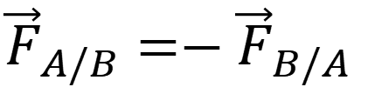
The Newton’s third law
“If a body A exert a force on a body B, the body B exert a force on body A.
These two forces have same magnitude and opposite directions”
$${\vec{F}}_{A/B}=−{\vec{F}}_{B/A}$$
In equation:
Force exerted by body A on body B
Force exerted by body B on body A
Notes:
PARLER LENTEMENT: As you can see, the equation describing this statement is very simple. At the left of the equation is the force exerted by the body A on the body B. It is minus the force exerted by the body B on the body A.

Slide 54
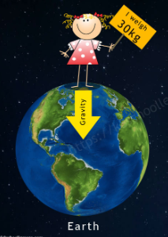


The Newton’s third law
Examples
The Earth exert on you the weight $\vec{w}$
you exert on the Earth a gravitational force $−\vec{w}$
$$\vec{w}$$
$$−\vec{w}$$
https://k8schoollessons.com/gravity-for-kids/
Notes:
PARLER LENTEMENT: Now, I will show you some example. The Earth exert on you a gravitational force, the weight w (double u). Then, you exert on the Earth a gravitational force, minus w (double u). You will certainly not have an impact on the motion of the Earth but this force you exert on it exist, it is not strictly zero.

Slide 55
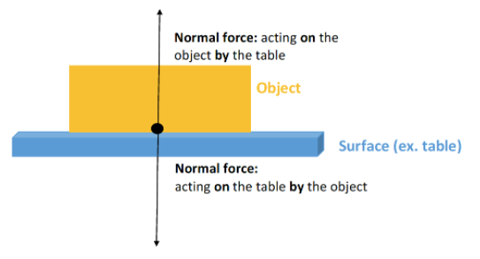
The Newton’s third law
Examples
Notes:
PARLER LENTEMENT: Here is another example. The surface of the table exert a normal force on the object. Then, the object exert a normal force on the table with same strength and opposite direction.

Slide 56
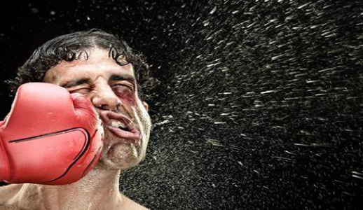
The Newton’s third law
Examples
https://wealthyretirement.com/trends/investing-bear-market-long-term/
The punch exert a force on the face
The face exert a force on the punch with opposite direction and same magnitude
Notes:
PARLER LENTEMENT: A last example to finish. If you hit somebody with a glove, your punch exert a force on his face, which is the reason why you can see such deformation. But the head of the person exert a force on your punch which is the reason why boxers can break their hand if they don’t take care.

Slide 57
III. The frictional forces
Notes:
PARLER LENTEMENT: We have seen the 3 Newton’s laws. Now, let’s describe few details about the frictional forces, or friction forces.

Slide 58
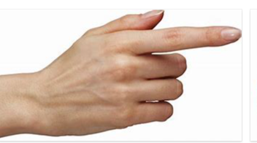
Introduction
Pushing force
If the strength of the pushing force is too low, the box don’t move
Box
table
Pushing force
If the strength of the pushing force is quite high, the box moves.
Box
table
Notes:
PARLER LENTEMENT: First, imagine this situation or try it with the objects you have at your table as your book of physics. If you try to push it with a too low strength, it will stay at rest even you push it. Then, you push it with an higher strength and it moves.

Slide 59
Introduction
Pushing force
If the pushing force is quite high, the box moves.
Box
table
If you stops to push, the box stops to move.
table
The reason of this behaviour
The table exert a frictional force on the box !
Notes:
PARLER LENTEMENT: Now that you succeed to push it and its moves, you stop to push it. Certainly, your book will stop to move. This is because of the table which have exerted a frictional force on your book. Maybe without know it, you just have experimented the both kinds of frictional force: the static friction force and the dynamic friction force.

Slide 60



Introduction
Forces exerted by the table on the box:
$$\vec{n}+\vec{f}$$
Normal force exerted by the table on the box.
$$\vec{n}$$
friction force $\vec{f}$
table
$\vec{n}+\vec{f}$ which represent the force exerted by the table on the box is named the “contact force”
(other forces exerted on the box such as the pushing force and the gravity are ignored here, but they exist, of course)
Notes:
PARLER LENTEMENT: The friction force is the force f exerted by the table on the box, here. As you know the other force exerted by the table on the box is the normal force. So the sum of the both vectors, vector f plus vector n describe the whole force exerted by the table on the box, which is named the contact force. Of course there are other force exerted on the box, such as the pushing force or the weight but I don’t show them.

Slide 61
The frictional forces
The frictional force has always its direction opposite to the motion.
The frictional force and the normal force exerted by the table are always perpendicular.
Pushing force
If the pushing force is too low, the box don’t move
Box
table
If the box don’t moves, to find the direction of the friction force exerted on the box, you just have to think “If the surface of contact was frictionless, what should be the motion of the box ?” (here toward the right), thus the friction force is here directed toward the left.
Notes:
PARLER LENTEMENT: The frictional force has always its direction opposite to the motion and the frictional force and the normal force exerted by the table are always perpendicular. If the box don’t moves, to find the direction of the friction force exerted on the box, you just have to think “If the surface of contact was frictionless, what should be the motion of the box ?” (here toward the right), thus the friction force is here directed toward the left.

Slide 62


Two kinds of friction
We have seen two kinds of situations, which correspond to two kinds of friction force:
Pushing force
If the pushing force is too low, the box don’t move
Static friction force
$$\vec{f_{s}}$$
table
Pushing force
If the pushing force is quite high, the box moves.
Box
Kinetic friction force
table
$$\vec{f_{k}}$$
The kinetic friction force is also named “dynamic friction force”
Notes:
PARLER LENTEMENT: Now, let’s describe the both kinds of friction force. The static friction force and the kinetic friction force, which is also named the dynamic friction force. If the pushing force is too low, the box don’t move, so it stays at rest. In that case, the friction force exerted is the static friction force f_s. If the pushing force strength is quite high, then the box moves and during its motion, the friction force exerted on it is the kinetic friction force f_k.

Slide 63

The kinetic friction force
The magnitude of the kinetic friction force on a body in motion on a surface is:
$$f_{k}=μ_{k}n$$
Important to remember
where
$n$ is the magnitude of the normal force exerted by the surface on the body
$μ_{k}$ is the coefficient of kinetic friction (which depends to the surface and the body)
Pushing force
If the pushing force is quite high, the box moves.
Box
Kinetic friction force
table
$$\vec{f_{k}}$$
Notes:
PARLER LENTEMENT: Here is the expression of the magnitude of the kinetic friction force. It is the product between the magnitude of the normal force and a coefficient which is named the coefficient of kinetic friction. This depends to the surface of contact between both bodies (it could be rough or soft) and which bodies you consider (it could be dry or wet wood, it could be metal or ice and so on).

Slide 64


The kinetic friction force
The magnitude of the kinetic friction force on a body in motion on a surface is:
$$f_{k}=μ_{k}n$$
Important to remember
where
$n$ is the magnitude of the normal force exerted by the surface on the body
$μ_{k}$ is the coefficient of kinetic friction ( a constant which depends to the surface and the body)
Examples:
$$μ_{k}≈0.04$$
Teflon on Teflon, or Teflon on steel
$$μ_{k}≈0.8$$
Rubber on dry concrete
Notes:
PARLER LENTEMENT: Here I give you examples of coefficient of kinetic friction, for instance for the Teflon on the Teflon on steel, and the coefficient of kinetic friction of the rubber on the dry concrete.

Slide 65

The static friction force
The magnitude of the kinetic friction force on a body in motion on a surface is such as:
$$f_{S}≤μ_{S}n$$
Important to remember
where
$n$ is the magnitude of the normal force exerted by the surface on the body
$μ_{S}$ is the coefficient of static friction (a constant which depends to the surface and the body)
Warning: The static friction force is not constant and depends to the force applied to move the body !
${(f_{s})}_{max}=μ_{S}n$ is the maximum magnitude of the static friction force
Notes:
PARLER LENTEMENT: Now, let’s describe the static friction force is equal or lower than the product between the magnitude of the normal force and a coefficient which is named the coefficient of static friction. So take care that the coefficient of static friction is not constant and depend to the force applied to move the body. But, at least, we can describe what is the maximum value of the magnitude of the static friction force. It is the coefficient of static friction multiplied by the magnitude of the normal force.

Slide 66





The static friction force
Because the body is at rest, the magnitude of the static friction force is easy to describe.
For instance:
$$\vec{n}$$
$$\vec{f_{s}}$$
Pushing force $\vec{f_{P}}$
Box at rest
$$\vec{w}$$
table
Using the first Newton’s law, the net force on the box equals zero (body at rest or moves at constant velocity).
$$\vec{f_{s}}=−\vec{f_{P}}$$
$$f_{S}=f_{p}$$
Here, the magnitude of the static friction force equals the magnitude of the pushing force.
Notes:
PARLER LENTEMENT: Don’t worry, because in the case of the static friction, it will be easy to describe it. We know that the body is at rest, In the example shown on the figure, the box is at rest, so the net force is equal zero. There are four forces exerted on the box, the pushing force, the normal force, the weight and the static friction force. Because the net force is zero, we know that the friction force and the pushing force have opposite direction and same magnitude.

Slide 67




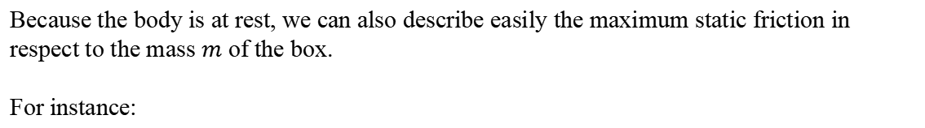
The static friction force
Because the body is at rest, we can also describe easily the maximum static friction in respect to the mass $m$ of the box.
For instance:
$$\vec{n}$$
$$\vec{f_{s}}$$
Pushing force $\vec{f_{P}}$
Box at rest
$$\vec{w}$$
table
Using the first Newton’s law, the net force on the box equals zero (body at rest or moves at constant velocity).
$$\vec{n}=−\vec{w}$$
$$n=w=mg$$
$${\left(f_{s}\right)}_{max}=μ_{S}n$$
$${\left(f_{s}\right)}_{max}=μ_{S}mg$$
Notes:
PARLER LENTEMENT: Using the first Newton’s law, the net force on the box equals zero. So the body at rest or moves at constant velocity. Here, the box stays at rest. So, we know that the normal force and the weight have opposite direction and same magnitude. We know then that the magnitude of the normal force is the mass of the box multiplied by the gravitational acceleration. Then we can describe what is the maximum value of the magnitude of the static friction force. What happens if the magnitude of the pushing force become higher than this maximum value ? The box will move and the friction force to consider will be the kinetic friction force.

Slide 68
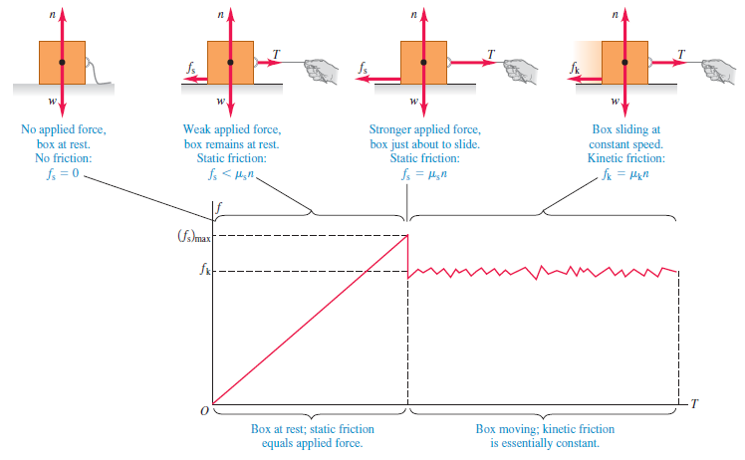
Example of magnitude of the friction force in respect to the applied force
If there is no applied force, the friction force is zero
The applied force here is a tension force of magnitude T, a pulling force using a rope
Notes:
PARLER LENTEMENT: Here is another example where static friction and kinetic friction are involved. There is a box on a table. Initially, there are only two forces exerted on the box, at rest: the weight and the normal force. The friction force exerted on the box is zero. You can see a graph which describe the friction force magnitude versus the magnitude of the pulling force exerted by the rope. Initially the rope don’t pull the box.

Slide 69

Magnitude of the friction force in respect to the applied force
The box is at rest, there is an applied force. The friction force is a static friction force such as:
$$f_{S}<μ_{S}n$$
The applied force here is a tension force of magnitude T, a pulling force using a rope
Notes:
PARLER LENTEMENT: Then the rope exerts a pulling force on the box, but not enough to permit to move the box. The box stays at rest and there is now four forces exerted on the box, the weight and the normal force, as previously, and the pulling force by the rope and the friction force, here the static friction force. When we increase the pulling force magnitude, the magnitude of the friction force increase also.

Slide 70

Magnitude of the friction force in respect to the applied force
The box is still at rest, the static friction force magnitude is maximum
$$f_{S}=μ_{S}n$$
If T increase, the box will moves
Notes:
PARLER LENTEMENT: Finally, the magnitude of the static friction force reaches its maximum value, the product between the normal force and the coefficient of static friction. If the magnitude of the tension force increase, the box will move.

Slide 71

Magnitude of the friction force in respect to the applied force
The box moves, the friction force is a kinetic friction force, such as:
$$f_{k}=μ_{k}n$$
Notes:
PARLER LENTEMENT: And then the box moves. Now the friction exerted is the kinetic friction force. Its magnitude is the magnitude of the normal force multiplied by the coefficient of kinetic friction. You can see on the graph that we can consider its magnitude is constant and don’t depend to the tension force which pulls the box.

Slide 72
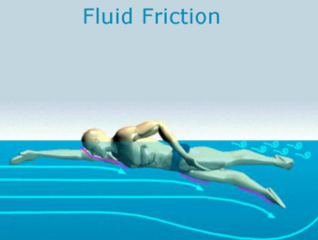
Friction force involved in fluid resistance
Any body in a fluid (liquid or gas) is submitted to a friction force involved with the fluid resistance (it is named also fluid friction).
The expression of the fluid friction force depends to the body in motion, the fluid and the velocity of motion (and can be plus or less complicated)
Notes:
PARLER LENTEMENT: Friction forces are not only what I have described you. For instance, a body in a fluid (liquid or gas) is submitted to a friction force involved with the fluid resistance (it is named also fluid friction). The expression of the fluid friction force depends to the body in motion, the fluid and the velocity of motion which can be plus or less complicated to describe.

Slide 73
IV. The dynamics of bodies in circular motion
Notes:
PARLER LENTEMENT: I stop here about the details involving the friction forces. And now, we will see together the dynamics involved with bodies in circular motion.

Slide 74

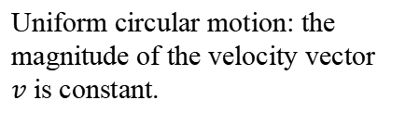
Question: What is property of the net force exerted on a body in uniform circular motion ?
Body in circular motion
Uniform circular motion: the magnitude of the velocity vector $v$ is constant.
$$\vec{v}$$
$$\vec{v}$$
$$R$$
$$\vec{v}$$
$$\vec{v}$$
Draw the net force and the acceleration vector of the body at different points of his circular motion. Describe its net force in terms of velocity vector, mass and radius of the circular motion (5 minutes.)
Notes:
PARLER LENTEMENT: To begin, here is a little question. A body has a uniform circular motion. I would first you describe on this figure the net force exerted on this body. Then please to describe the magnitude of the net force in terms of the body mass, the velocity and the radius of the circular motion.

Slide 75
Question: What is property of the net force exerted on a body in uniform circular motion ?
$$\vec{v}$$
$$\vec{a}$$
$$\vec{v}$$
$$\vec{a}$$
$$\vec{a}$$
$$\vec{a}$$
$$\vec{v}$$
$$\vec{v}$$
Uniform circular motion: the magnitude of the velocity vector $v$ is constant.
We have seen the acceleration $\vec{a}$ is directed radially inward.
Notes:
PARLER LENTEMENT: So, here is the solution. If we have to use Newton’s second law. We have seen that in the case of the uniform circular motion, the acceleration vector of the particle is radially inward, which means it is directed toward the center of the circle.

Slide 76



Question: What is property of the net force exerted on a body in uniform circular motion ?
$$\vec{v}$$
$$\vec{a}$$
$$\vec{F}=m\vec{a}$$
$$\vec{v}$$
$$\vec{F}$$
$$\vec{a}$$
$$\vec{a}$$
$$\vec{a}$$
$$\vec{v}$$
$$\vec{v}$$
Uniform circular motion: the magnitude of the velocity vector $v$ is constant.
We have seen the acceleration $\vec{a}$ is directed radially inward.
According to the Newton’s second law, the net force $\vec{F}$ is also directed radially inward.
Notes:
PARLER LENTEMENT: And according to the Newton’s second law, the net force is the product between the mass of the particle and its acceleration vector. So, the net force exerted on the particle and its acceleration vector have the same direction. The net force is then radially inward.

Slide 77



Net force on a body in uniform circular motion
The normal (i.e. radial) and tangential components of the acceleration are:
$$\vec{v}$$
$$a_{n}=\frac{v^{2}}{R}=a$$
$$\vec{a}$$
$$a_{t}=\frac{dv}{dt}=0$$
$$\vec{F}=m\vec{a}$$
$$\vec{v}$$
The magnitude of the net force is
$$\vec{a}$$
$$F=ma=\frac{mv^{2}}{R}$$
$$\vec{a}$$
R
$$\vec{v}$$
$$\vec{v}$$
Important to remember
Notes:
PARLER LENTEMENT: We have described previously the normal and the tangential acceleration in the case of the uniform circular motion. So, we can describe the magnitude of the net force exerted on the particle in the uniform circular motion. It is the mass of the particle, multiplied by the square of its velocity and divided by the radius of the circle.

Slide 78
Net force on a body in uniform circular motion
The normal (i.e. radial) and tangential components of the acceleration are:
$$\vec{v}$$
$$a_{n}=\frac{v^{2}}{R}=a$$
$$\vec{a}$$
$$a_{t}=\frac{dv}{dt}=0$$
$$\vec{F}=m\vec{a}$$
$$\vec{v}$$
The magnitude of the net force is
$$\vec{a}$$
$$F=ma=\frac{mv^{2}}{R}$$
$$\vec{a}$$
R
$$\vec{v}$$
$$\vec{v}$$
Important to remember
This relation is still valid if the body move along a circular arc instead of a full circle.
$$\vec{v}$$
$$\vec{F}=m\vec{a}$$
Notes:
PARLER LENTEMENT: This relation is still valid if the body move along a circular arc instead of a full circle.

Slide 79


Net force on a body in uniform circular motion
$$\vec{v}$$
$$\vec{F}$$
$$\vec{a}$$
From this position, the body is submitted to a net force radially inward.
$$\vec{v}$$
$$\vec{F}=\vec{0}$$
Notes:
PARLER LENTEMENT: Here is an other example. Imagine that first the particle has a linear uniform motion, which means the net force exerted on it is zero. From the position you see a net force directed radially inward is exerted on the particle. What happens about the motion of the particle ?

Slide 80
Net force on a body in uniform circular motion
$$\vec{a}$$
R
$$\vec{F}$$
$$\vec{v}$$
After this position, no net force is exerted to this body
$$\vec{F}$$
$$\vec{a}$$
From this position, the body is submitted to a net force radially inward.
$$\vec{v}$$
$$\vec{F}=\vec{0}$$
Notes:
PARLER LENTEMENT: In that case, the motion become a uniform circular motion. And if after the position shown on the figure the net force exerted on the particle is not radially inward but simply zero …

Slide 81
Net force on a body in uniform circular motion
$$\vec{v}$$
$$\vec{v}$$
$$\vec{v}$$
$$\vec{F}=\vec{0}$$
$$\vec{F}=\vec{0}$$
$$\vec{a}$$
R
$$\vec{F}$$
$$\vec{v}$$
After this position, no net force is exerted to this body
$$\vec{F}$$
$$\vec{a}$$
From this position, the body is submitted to a net force radially inward.
$$\vec{v}$$
$$\vec{F}=\vec{0}$$
Notes:
PARLER LENTEMENT: Then the motion of the particle become again a uniform linear motion.

Slide 82
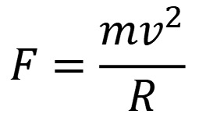
Net force on a body in uniform circular motion
$$\vec{v}$$
$$\vec{v}$$
$$\vec{v}$$
$$\vec{F}=\vec{0}$$
$$\vec{F}=\vec{0}$$
$$\vec{a}$$
R
$$\vec{F}$$
$$\vec{v}$$
After this position, no net force is exerted to this body
$$\vec{F}$$
$$\vec{a}$$
From this position, the body is submitted to a net force radially inward.
$$\vec{v}$$
$$\vec{F}=\vec{0}$$
This relation is still valid if the body move along a circular arc instead of a full circle:
$$F=\frac{mv^{2}}{R}$$
Notes:
PARLER LENTEMENT: To summary, when the particle moves as a uniform circular motion, it could be a full circle or a circular arc of the circle, this expression of the net force is still valid.

Slide 83



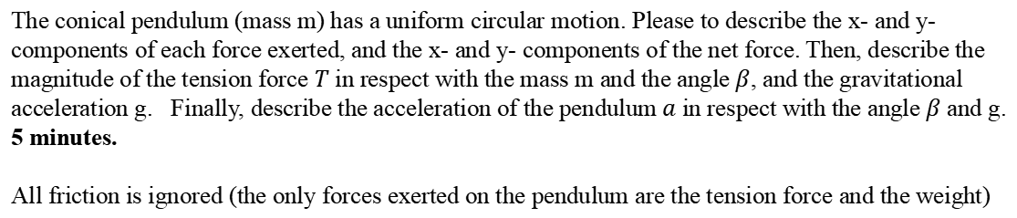
Ex: A conical pendulum
$$β$$
$$\vec{T}$$
$$y$$
$$R$$
mass $m$
$$x$$
$$\vec{w}$$
The conical pendulum (mass m) has a uniform circular motion. Please to describe the x- and y- components of each force exerted, and the x- and y- components of the net force. Then, describe the magnitude of the tension force $T$ in respect with the mass m and the angle $β$, and the gravitational acceleration g. Finally, describe the acceleration of the pendulum $a$ in respect with the angle $β$ and g. 5 minutes.
All friction is ignored (the only forces exerted on the pendulum are the tension force and the weight)
Notes:
PARLER LENTEMENT: To finish, here is a little exercise. It is the conical pendulum, The particle of a mass m has a uniform circular motion. The particle is attached to a rope which have also a circular motion, and this rope exert a tension force T on the particle. The particle is also submitted to the weight w. There is a certain angle Beta between the rope and the vertical, which is constant. R is the radius of the circular motion. The y-direction is the vertical direction. The x-direction is directed toward the center of the circular motion. We consider there is no friction. Please to describe the x- and y -components of the tension force of the weight exerted on the particle, and then describe the acceleration of the pendulum (which is here the particle we study the motion)

Slide 84



Ex: A conical pendulum
Weight $\vec{w}$:
$$w_{x}=0$$
rope of length L
$$w_{y}=−mg$$
$$β$$
$$\vec{T}$$
$$y$$
$$R$$
mass $m$
$$x$$
$$\vec{w}$$
Notes:
PARLER LENTEMENT: First, let’s describe the weight. This is quite easy. The x-component of the weight is zero because the weight is directed downward. Thus the y-component of the weight is minus the mass multiplied by the gravitational acceleration g. Take care of the sign here. The y-axis is directed upward but the weight is directed downward,

Slide 85



Ex: A conical pendulum
Weight $\vec{w}$:
$$w_{x}=0$$
rope of length L
$$w_{y}=−mg$$
$$β$$
Tension force $\vec{T}$:
$$T_{x}=T\sin{β}$$
$$\vec{T}$$
$$T_{y}=T\cos{β}$$
$$y$$
$$R$$
mass $m$
$$x$$
$$\vec{w}$$
Notes:
PARLER LENTEMENT: The x and y components of the tension force are quite easy to describe in respect with theta,

Slide 86


Ex: A conical pendulum
Weight $\vec{w}$:
$$w_{x}=0$$
rope of length L
$$w_{y}=−mg$$
$$β$$
Tension force $\vec{T}$:
$$T_{x}=T\sin{β}$$
$$\vec{T}$$
$$T_{y}=T\cos{β}$$
$$y$$
Using the Newton’s second law:
The components of the net force exerted on the pendulum are:
$$R$$
mass $m$
$$x$$
$$F_{x}=T_{x}+w_{x}$$
$$\vec{w}$$
$$F_{y}=0=T_{y}+w_{y}$$
Notes:
PARLER LENTEMENT: And we can describe the x- and y-components of the net force exerted on the particle. It is the sum of the x- and y- components of the tension force and the weight. The motion of the particle is a uniform circular motion, so the net force is directed radially inward, which means its y-component is equal to zero.

Slide 87


Ex: A conical pendulum
Weight $\vec{w}$:
$$w_{x}=0$$
rope of length L
$$w_{y}=−mg$$
$$β$$
Tension force $\vec{T}$:
$$T_{x}=T\sin{β}$$
$$\vec{T}$$
$$T_{y}=T\cos{β}$$
$$y$$
Using the Newton’s second law:
The components of the net force exerted on the pendulum are:
$$R$$
mass $m$
$$x$$
$$F_{x}=T_{x}+w_{x}$$
$$\vec{w}$$
$$F_{y}=0=T_{y}+w_{y}$$
$$T_{y}=mg=T\cos{β}$$
$$T=\frac{mg}{\cos{β}}$$
Notes:
PARLER LENTEMENT: We obtain a description of the magnitude of the tension force T.

Slide 88


Ex: A conical pendulum
The components of the net force exerted on the pendulum are:
$$β$$
$$F_{x}=T_{x}+w_{x}$$
$$F_{x}=T_{x}$$
because
$$w_{x}=0$$
$$\vec{T}$$
$$F_{x}=ma_{n}=ma$$
$$y$$
$$R$$
mass $m$
$$x$$
$$\vec{w}$$
Notes:
PARLER LENTEMENT: Now, let’s to describe the acceleration of the pendulum. The x-component of the net force is the mass of the particle multiplied by its acceleration. And we know that the x-component of the net force is also the x-component of the tension force, because the weight has no x-component.

Slide 89


Ex: A conical pendulum
The components of the net force exerted on the pendulum are:
$$β$$
$$F_{x}=T_{x}+w_{x}$$
$$F_{x}=T_{x}$$
because
$$w_{x}=0$$
$$\vec{T}$$
$$F_{x}=ma_{n}=ma$$
$$y$$
The motion is uniform circular motion, the net force and the acceleration are radially inward (along the x-direction).
$$R$$
mass $m$
$$x$$
$$a=\frac{T\sin{β}}{m}$$
$$T\sin{β}=ma$$
$$\vec{w}$$
Notes:
PARLER LENTEMENT: We obtain an expression of the acceleration in terms of T the magnitude of the tension force, the angle beta, and the mass m. If you find this result, that is great ! But the exercise ask about the acceleration in terms of beta and the gravitational acceleration …

Slide 90



Ex: A conical pendulum
The components of the net force exerted on the pendulum are:
$$β$$
$$F_{x}=T_{x}+w_{x}$$
$$F_{x}=T_{x}$$
because
$$w_{x}=0$$
$$\vec{T}$$
$$F_{x}=ma_{n}=ma$$
$$y$$
The motion is uniform circular motion, the net force and the acceleration are radially inward (along the x-direction).
$$R$$
mass $m$
$$x$$
$$a=\frac{T\sin{β}}{m}$$
$$T\sin{β}=ma$$
$$\vec{w}$$
And $T=\frac{mg}{\cos{β}}$
$$a=\frac{mg}{\cos{β}}\frac{\sin{β}}{m}$$
$$a=g\tan{β}$$
You don’t need to remember this result, but you must to be able to find it by yourself.
Notes:
PARLER LENTEMENT: So we put in our result the expression of the magnitude of the tension force, and we obtain simply that the acceleration of the pendulum is g times the tangent of the angle beta. That’s all for this exercise. This exercise is a bit difficult. It doesn’t matter if you need 10 or 15 minutes to do it, but you should be able to do it.

Slide 91
End of the lesson 4
Tonight, as I will do every weeks, I will upload your homework. Deadline to achieve it: Monday (I will give you the solution of the homework Tuesday).
Notes:
PARLER LENTEMENT: That’s all for this lecture about the Newton’s laws of motion. Tonight, as I will do every weeks, I will upload your homework. The deadline to achieve it is Monday. Thank you very much to came and see you after the spring vacations ! Have a nice vacations.

